Slide 1
React Components Lifecycle & Forms

Slide 2
What is Component Lifecycle in React?
React components have three main stages in their lifecycle :
Mounting or initialization.
Updation in state or props.
Unmounting.
Each component has several "lifecycle methods" that you can override to run code at particular times in the process. Methods prefixed with will are called right before something happens, and methods prefixed with did are called right after something happens.

Slide 3
Mounting
These methods are called when an instance of a component is being created and inserted into the DOM:
First Render
constructor
componentWillMount
render
componentDidMount

Slide 4
Deprecated and New in 16.3.x and onwards
Deprecated -
UNSAFE_ComponentWillMount( )
New-
static getDerivedStateFromProps( )

Slide 5
Updating
An update can be caused by changes to props or state. These methods are called when a component is being re-rendered
Re Render
componentWillReceiveProps
shouldComponentUpdate
componentWillUpdate
render
componentDidUpdate

Slide 6
Deprecated and New in 16.3.x and onwards
Deprecated -
UNSAFE_componentWillUpdate( )
UNSAFE_componentWillReceiveProps( )
New -
static getDerivedStateFromProps( )
getSnapShotBeforeUpdate( )

Slide 7
Unmounting
This method is called when a component is being removed from the DOM:
componentWillUnMount
First Render

Slide 8
Error Handling
static getDerivedStateFromError( )
componentDidCatch( )

Slide 9
defaultProps(es6)
//es6
class Greeting extends React.Component { render() {
} }
Greeting.defaultProps = { name: 'Mary' };
Greeting.propTypes = { name: React.PropTypes.string },

Slide 10
defaultProps(es6)
//es6
class Greeting extends React.Component { static defaultProps = { name: 'Mary' };
static propTypes = { name: React.PropTypes.string };
render() {
} }

Slide 11
getInitialState(es6)
class SayHello extends React.Component({ constructor(props) { super(props); this.state = { message: 'Hello!', }; } render: function() { //.. } });

Slide 12
componentWillMount
Called just before the render() is called.
We have the initial state and default props by this state.
Is okay to call this.setState() here.
componentWillMount() { console.log('Component WILL MOUNT!') }

Slide 13
render
Available multiple lifecycle stages.
Never call setState or try to access dom nodes inside render.
Render returns a single react dom node which can contain multiple dom nodes.
render() { return <div> rendering component <div/> ;
}

Slide 14
componentDidMount
Called after the render method.
Dom is available to make some changes.
componentDidMount() { console.log('Component DID MOUNT!') }

Slide 15
componentWillReceiveProps
Gets called when new props are passed to the component.
componentWillReceiveProps(newProps) { this.setState({ name: newprops.name }) }

Slide 16
shouldComponentUpdate
Gets called when props or state changes
Will stop updation of component if returns false.
shouldComponentUpdate(newProps, newState) { return true
}

Slide 17
componentWillUpdate
Same as componentWillMount, just gets called at time state or props are updated.
componentWillUpdate(nextProps, nextState) { console.log('Component WILL UPDATE!'); }

Slide 18
componentDidUpdate
Same as componentDidMount, just gets called at time state or props are updated.
componentDidUpdate(prevProps, prevState) { console.log('Component DID UPDATE!') }

Slide 19
componentWillUnmount
Gets called when component unmounts.
Is best time when you want to clear any type of listener in your component.
componentWillUnmount() { console.log('Component WILL UNMOUNT!') }

Slide 20
Forms
Forms in React are different than plain HTML forms. A component has its data in its state and/or props received from parent. So we need to design our Form component that reads data from its state and component should be aware of the events (i.e. focus, unfocus, clicks, keypress etc) and update its state accordingly.
Based on how we design our Form we can have two different type of forms
Uncontrolled and Controlled forms.

Slide 21
Uncontrolled Forms
Uncontrolled forms are similar to the tradition HTML.
class Form extends Component {
render( ) {
return (
<form>
<input type=”text” />
</form>
)
}
}

Slide 22
Controlled Forms
A controlled input accepts its current value as a prop, as well as a callback to change that value. You could say it’s a more “React way” of approaching this.
<input value={someValue} onChange={handleChange} />
sdfsdf
the value of this input (someValue) has to live in the state somewhere. Typically, the component that renders the input (Form component) saves that in its state

Slide 23
Controlled Forms cond..
class Form extends Component {
constructor(){
super()
This.state = { name: ‘John’ }
}
render () {
return (
<input type=”text” value={this.state.name} />
)
}
}

Slide 24
Handling Form Events
We can handle form events by providing a handler callback to our controlled inputs. In below example we are checking what user is typing and then converting it into upper case.
class Form extends Component {
constructor(){
super()
This.state = { name: ‘’ }
this.handleChange = this.handleChange.bind(this)
}
handleChange(event){
this.setState({ name: event.target.value.toUpperCase()})
}
render () {
return (
<input type=”text” value={this.state.name} onChange={this.handleChange} />
)
}
}

Slide 25
Form validation and error handling
In below example, we’re going to create a simple signup form and onSubmit we’re going to validate if user has entered ‘name’, password and confirm password should be same. .
import React, { Component } from 'react'
export default class Form extends Component {
constructor(){
super()
this.state = {
name: '',
pass: '',
cnf_pass: '',
message: ''
}
}

Slide 26
example
handleChange(e) {
let state = {}
state[e.target.name] = e.target.value
this.setState(state)
}
handleSubmit (event) {
event.preventDefault();
if(!this.state.name || !this.state.pass || !this.state.cnf_pass){
this.setState({message: 'All fields are required'})
}
else if(this.state.pass !== this.state.cnf_pass){
this.setState({message: 'passwords do not match!'})
}
else {
this.setState({message: "You're registered"})
}
}

Slide 27
example
render () {
return (
<form onSubmit={this.handleSubmit.bind(this)}>
<p>
{ this.state.message }
</p>
<input type='text' name='name' onChange={this.handleChange.bind(this)} value={this.state.name} placeholder="name"/>
<input type='password' name='pass' onChange={this.handleChange.bind(this)} value={this.state.pass} placeholder="password"/>
<input type='password' name='cnf_pass' onChange={this.handleChange.bind(this)} value={this.state.cnf_pass} placeholder="confirm your password"/>
<input type="submit" value="Signup"/>
</form>
)
}
}

Slide 28
Keys
React keys are useful when working with dynamically created components or when your lists are altered by users. Setting the key value will keep your components uniquely identified after the change.
Let’s create a list of users dynamically
class Keys extends Component {
constructor(props) {
super(props);
this.state = {
users: ['Chandler', 'Monica', 'Ross', 'Pheobe', 'Rachel']
}
}
render() {
let userList = this.state.users.map((user,i) => {
return <li key={i}> {user} </li>
})
return (
<div>
{userList}
</div>
);
}
}

Slide 29
Keys contd..
If we add or remove some elements in the future or change the order of the dynamically created elements, React will use the key values to keep track of each element.

Slide 30
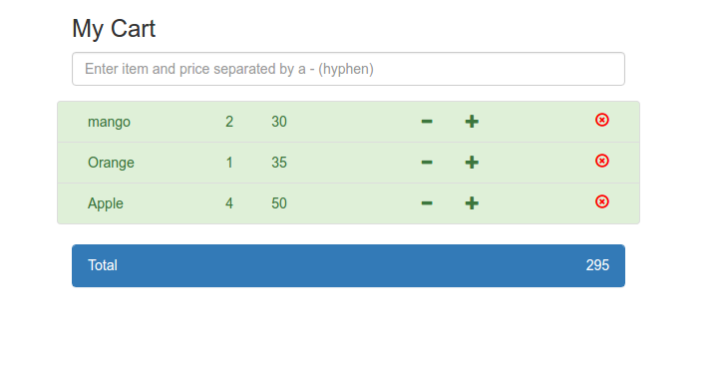
Exercise
Create a cart application having a form component to add new items in cart, a itemlist component to display added items and CartTotal to show total amount.

